Slide 1
Psychological interventions for people affected by the COVID-19 epidemic
By Luca De Masi, Allegra Ghiani, Swami Spedicato

Slide 2
Introduction
Coronavirus epidemic has been spreading in China for over a month. Since then, the National Health Commission has established new instructions owing to the emerging psychological crisis of people affected by COVID-19. All types of institution got busy to provide online platforms available throughout the whole territory of China. Despite of this, some experts affirm that the efforts have not been enough.

Slide 3
The relevance of psychological interventions during a crisis
Organization of psychological interventions in China must be improved. Several countries in the west, such as UK, have established new procedures due to the emergency. In 2004, the Chinese Government issued guidelines on strengthening mental health initiatives. During the SARS epidemic, several counselling telephone helplines were opened for the public, and they became more and more important.

Slide 4
The lack of an authoritative organization in psychological interventions
Little attention is paid to the implementation of interventions. Overall, planning in case of outbreaks is not adequate. Hence, most medical departments act independently without communicating with each other, there is a loss of time and, in addition no result is reached.

Slide 5
Cooperation among mental health institutions is the key
The cooperation between community health services and mental-health-care institutions has been decoupled. After the assessment of the mental health states of individuals affected by the epidemic, patients cannot be assigned according to the severity of their condition. And at the end of the remission of the viral infection, patients cannot be suddenly discharged by the hospital.

Slide 6
The absence of specialized teams
Another reason for the difficulties in giving appropriate psychological interventions, lies in the absence of teams of specialists.
The teams are composed by people with no professional experience in the matter, resulting in inadequate interventions. This can be avoided by strengthening their training, or reviewing constantly their experience.

Slide 7
Different treatments for different people
In the National Health Commission guidelines for psychological intervention, figured out that different types of people need different treatments.
Those groups are composed by infected individuals, relatives, medical personnel, susceptible people, those who refused recovery and the general public.

Slide 8
Interventions should be adapted to the necessity of the patient
To give an appropriate psychological support, disease progression must be taken into account.
For instance, a patient who has been dismissed from recovery, can still suffer from mental-health problems, caused by the crisis passed.

Slide 9
The contradiction in mental health care during the COVID-19 crisis
For social distancing reason, an infected person cannot enter in contact with non-essential personnel, such as psychiatrists, yet, he might need them.
Thus, the only ones who can provide psychological support, are health-care workers; nonetheless, they do not have an adequate preparation to give an appropriate intervention.
This picture is just describing contradiction in an umoristic way, it is not meant to be amusing or to humor the crisis.

Slide 10
In spite of the increased number of experts, they are still not enough
Despite the fact that the number of licensed psychotherapists, social workers, and psychological counselors is increasing every years since 2015, their numbers are still too few to meet the needs of patients with mental disorders.
This make training of mental health professionals at different levels urgently required by the Chinese Government.

Slide 11
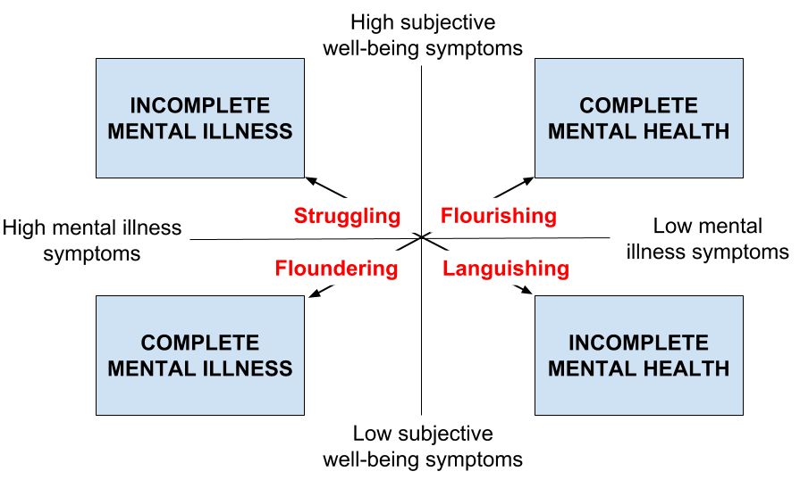
The basis for the intervention lays in an evaluation of overall risks
The psychological intervention of a patient should be based on a general evaluation of the risk factors that could lead to a mental health crisis such as bereavement, injury to self or family members, life-threatening circumstances, panic, separation from family and low household income.

Slide 12
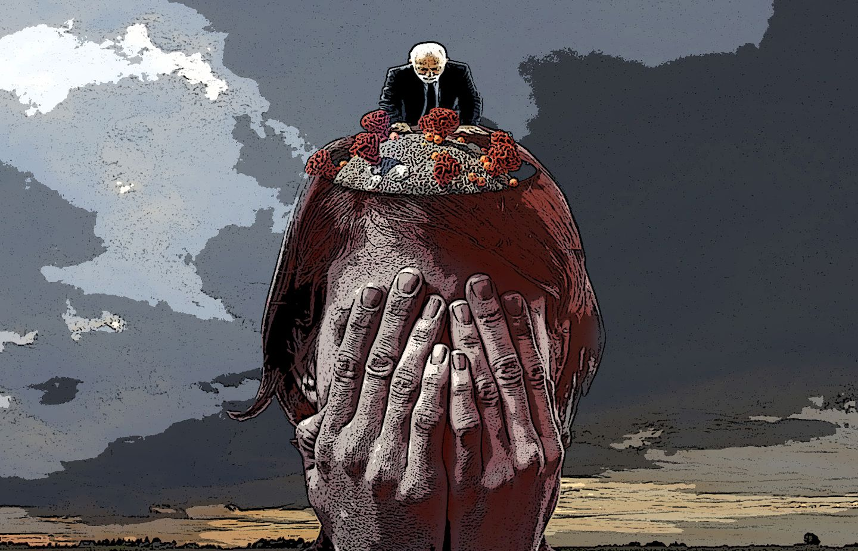
What past crisis taught us
From previous catastrophes we have learned the importance of pre-establishing community coalitions to mobilise resources efficiently and effectively and to respond successfully to the disaster-related mental health needs of affected individuals; procedures that, in China, should be improved.

Slide 13
Conclusion
The outbreak of COVID-19 has shown many problems with the provision of psychological intervention in China and there has been many suggestion that the government could use to establish and improve the intervention system based on sound scientific advice.

Slide 14
The End

